Slide 1
Session 2020-21 CSTE-3101 Communication Engineering

Slide 2
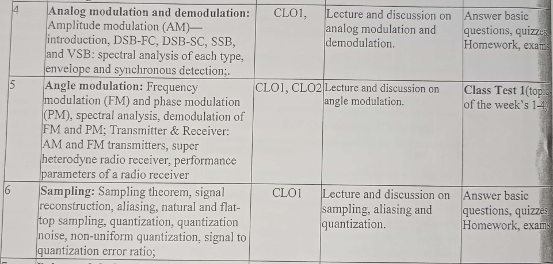
Week: 4-8

Slide 3
Book Reference
Modern digital and analog communication: B. P Lathi
Communication systems by Simon S. Haykin
Communication systems: Analog and Digital by Sanjay Sharma
Data Communications and Networking by Behrouz A. Forouzan, McGraw-Hill.

Slide 4
AM Signal Power

Slide 5
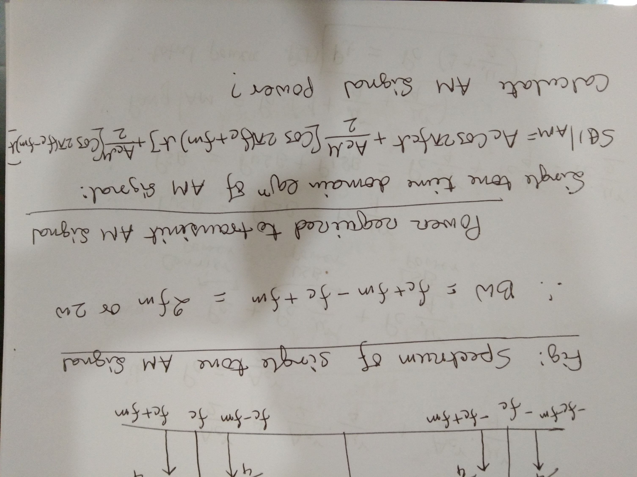

Slide 6
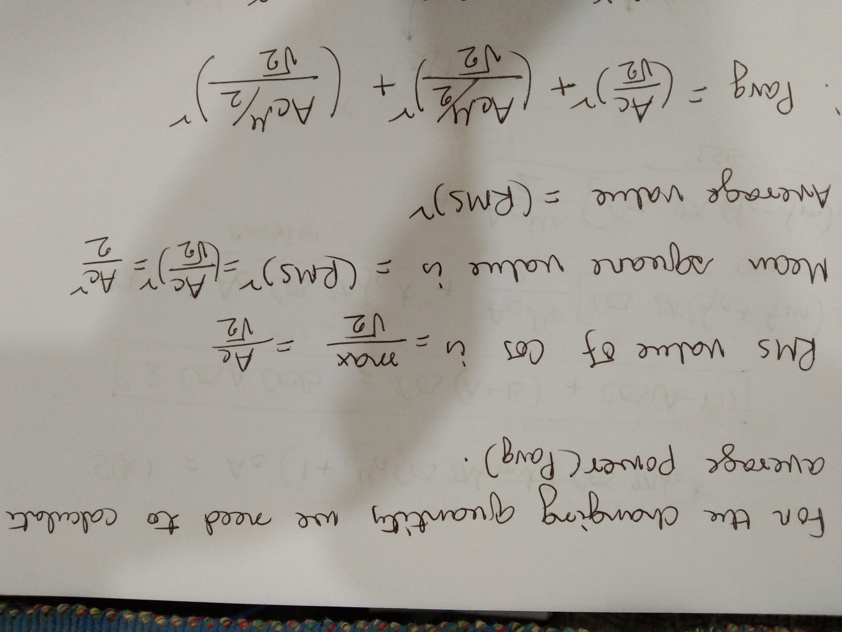

Slide 7
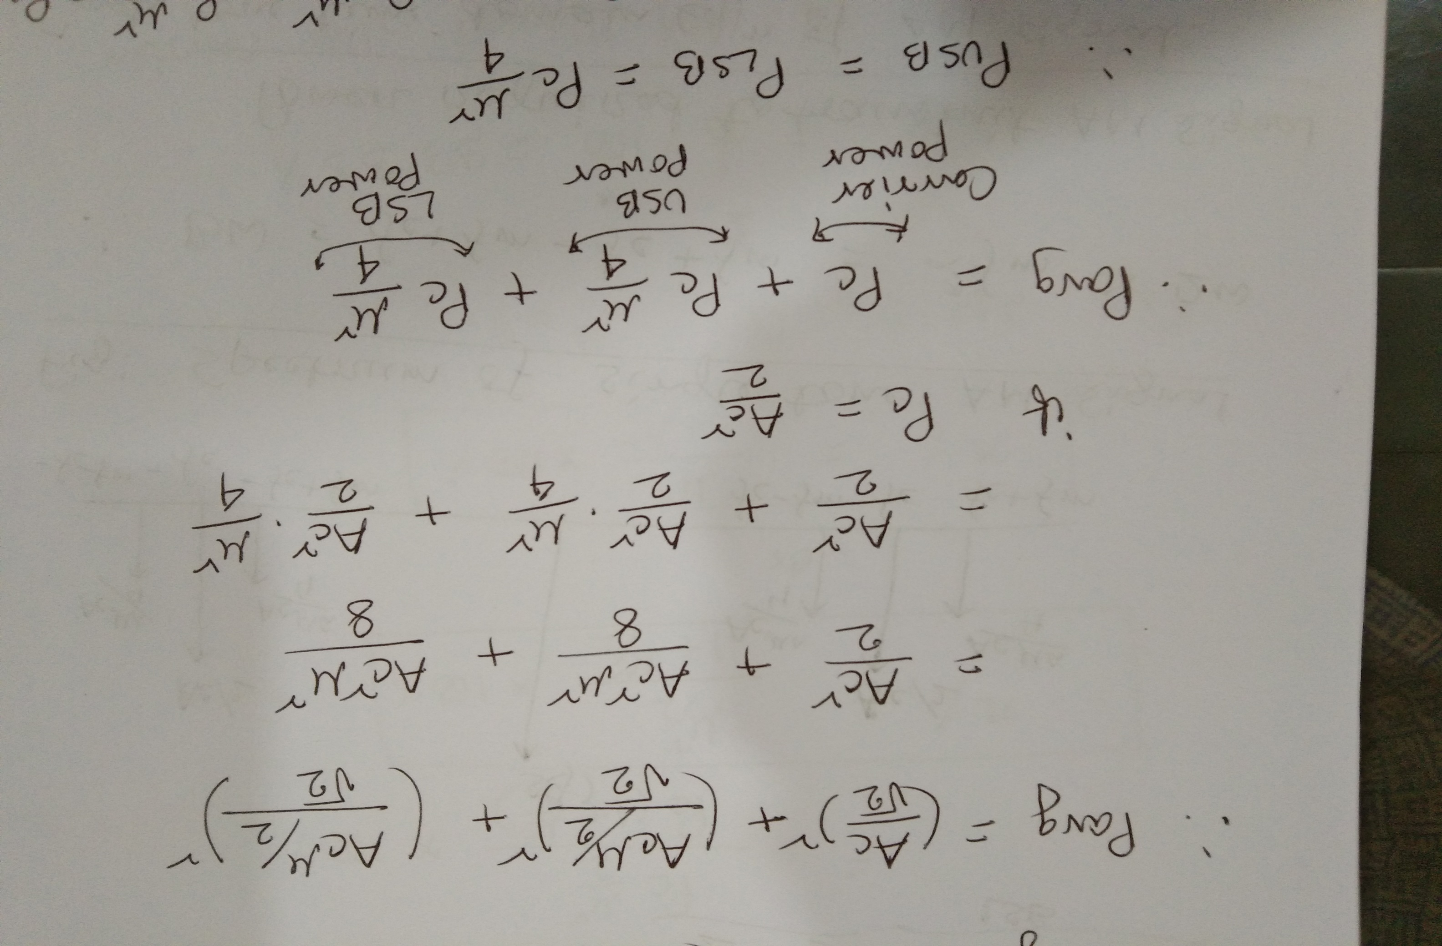

Slide 8
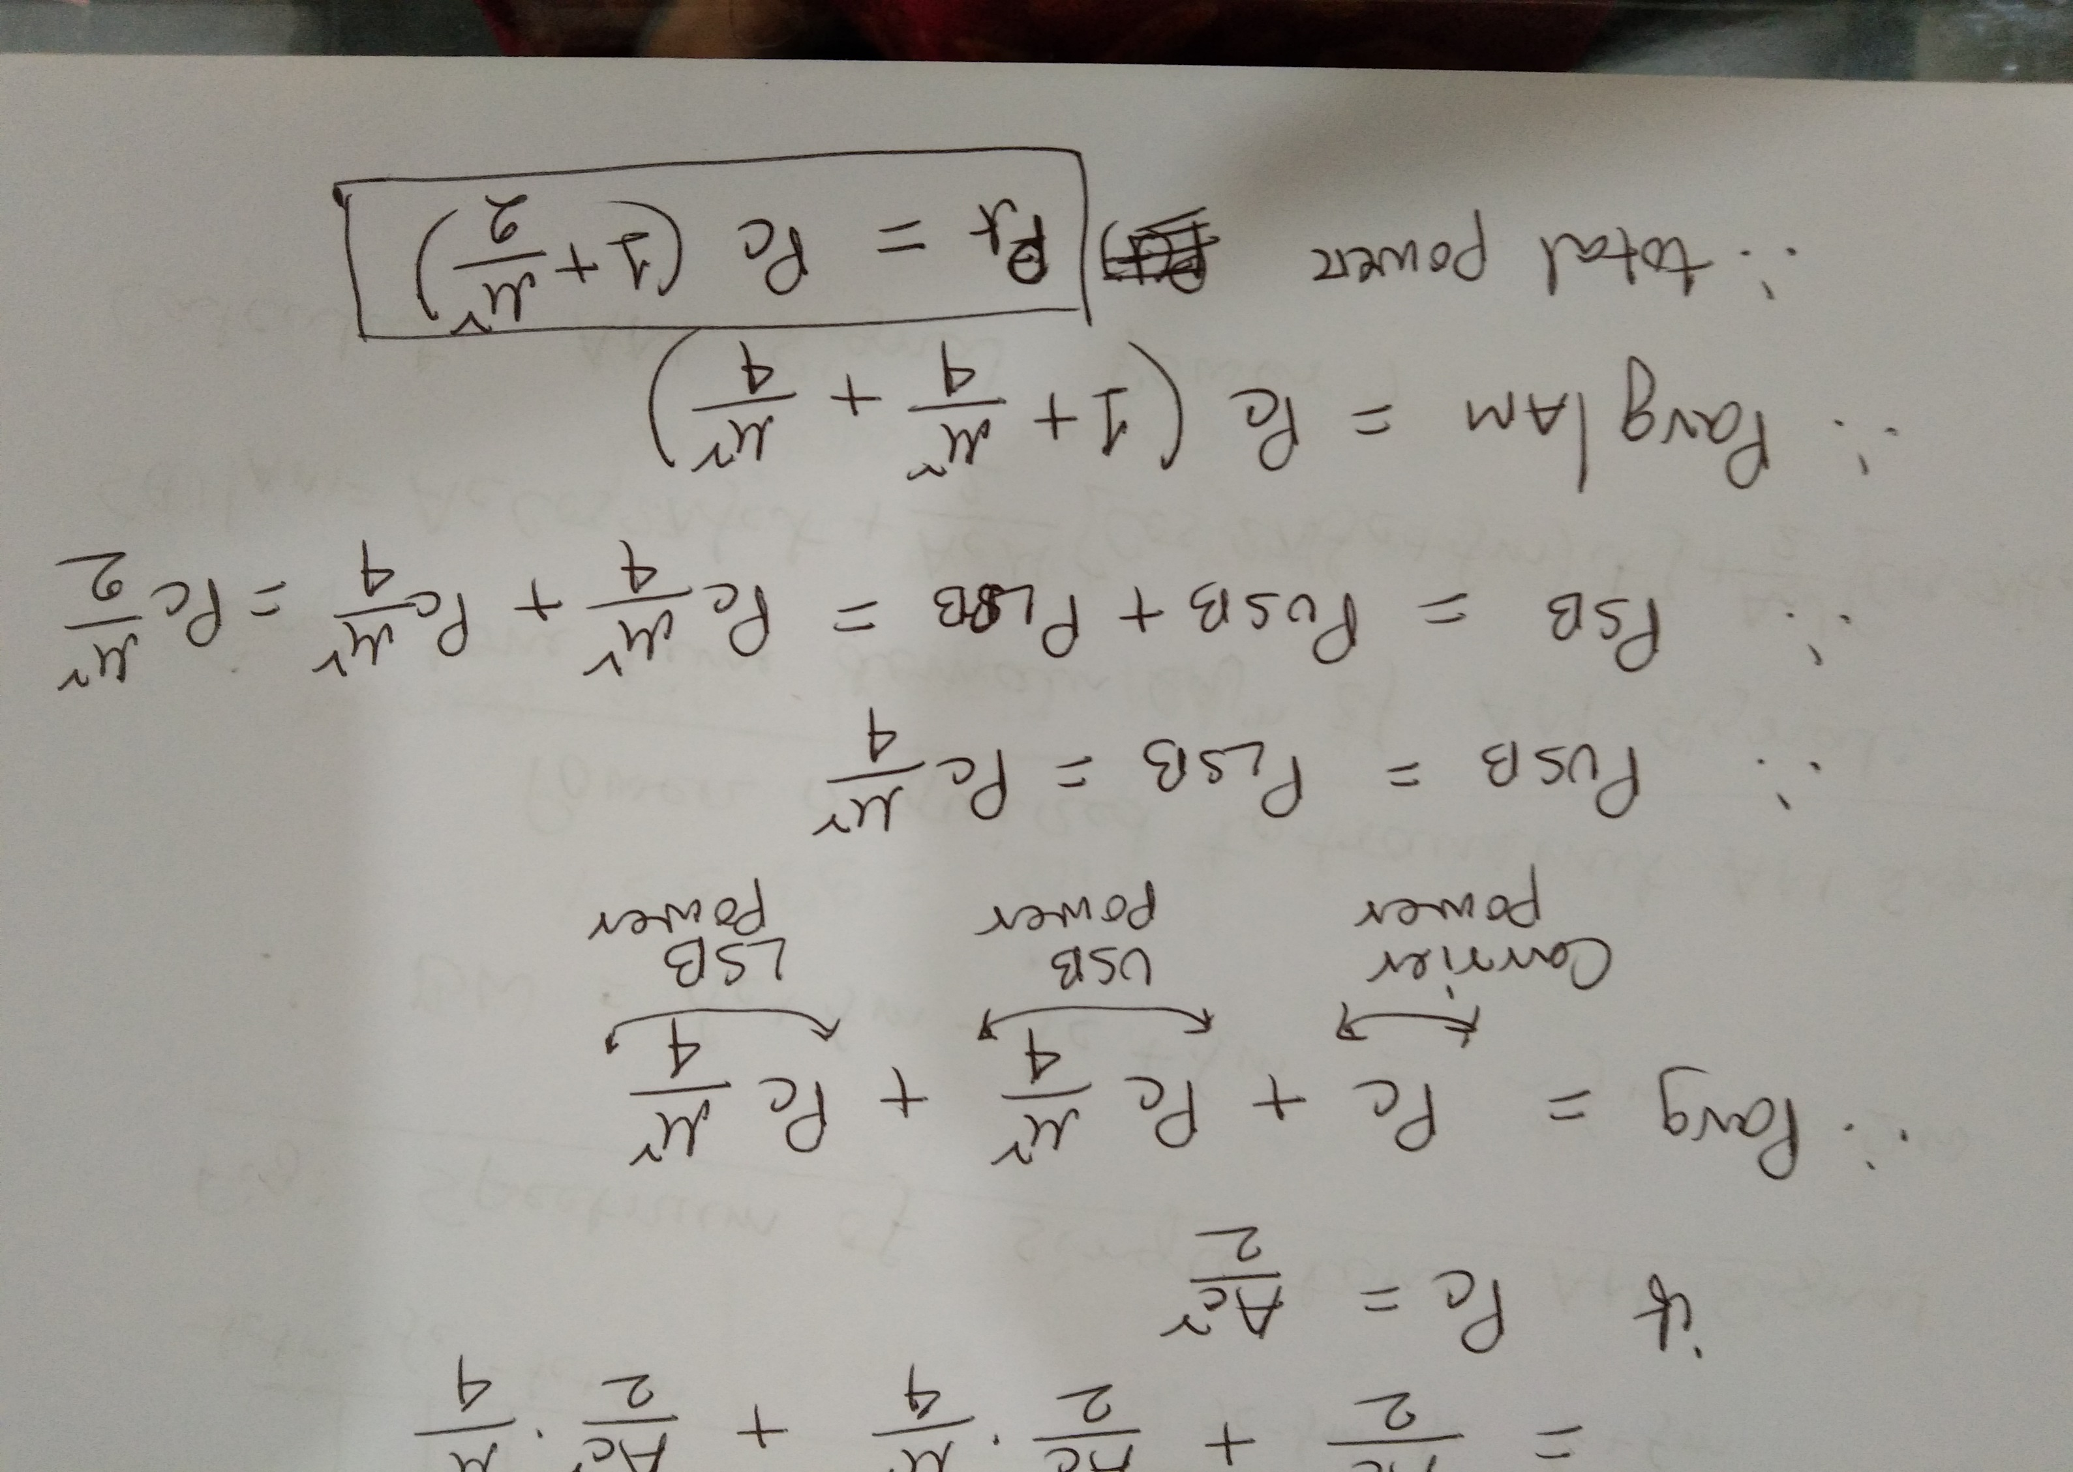

Slide 9
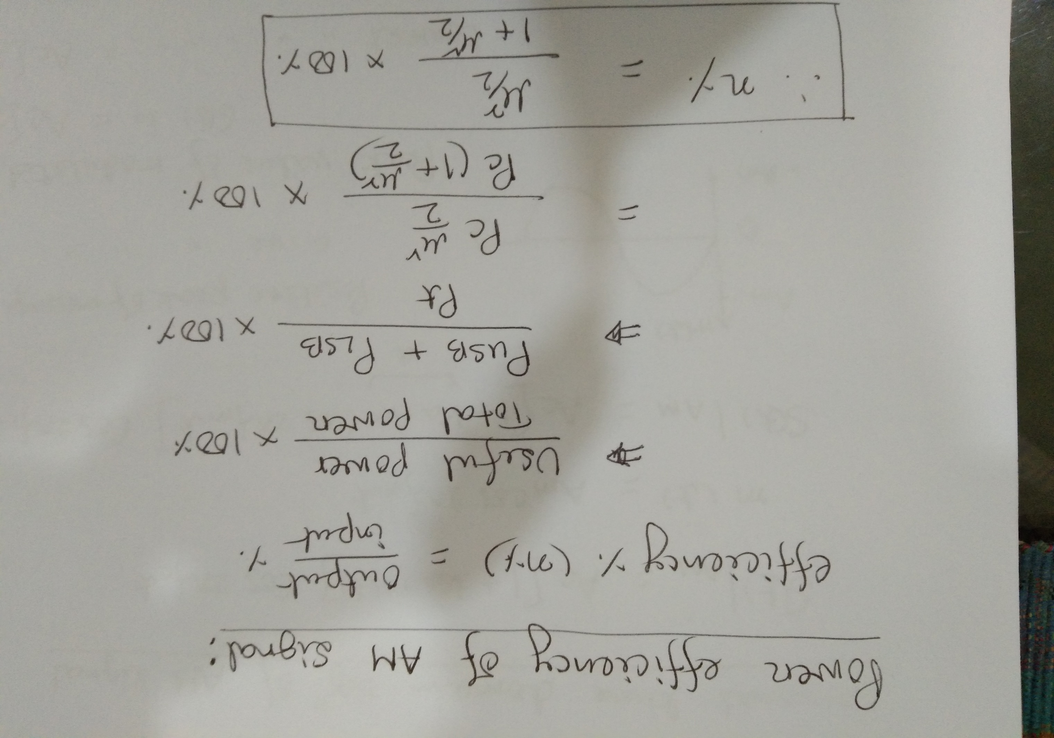

Slide 10
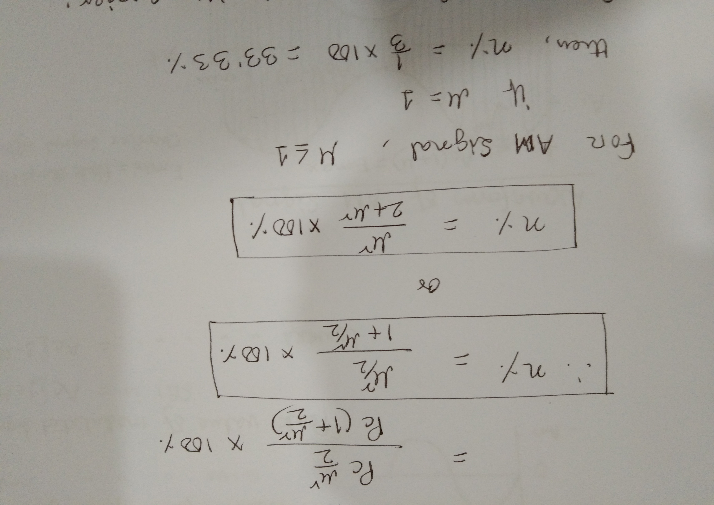

Slide 11
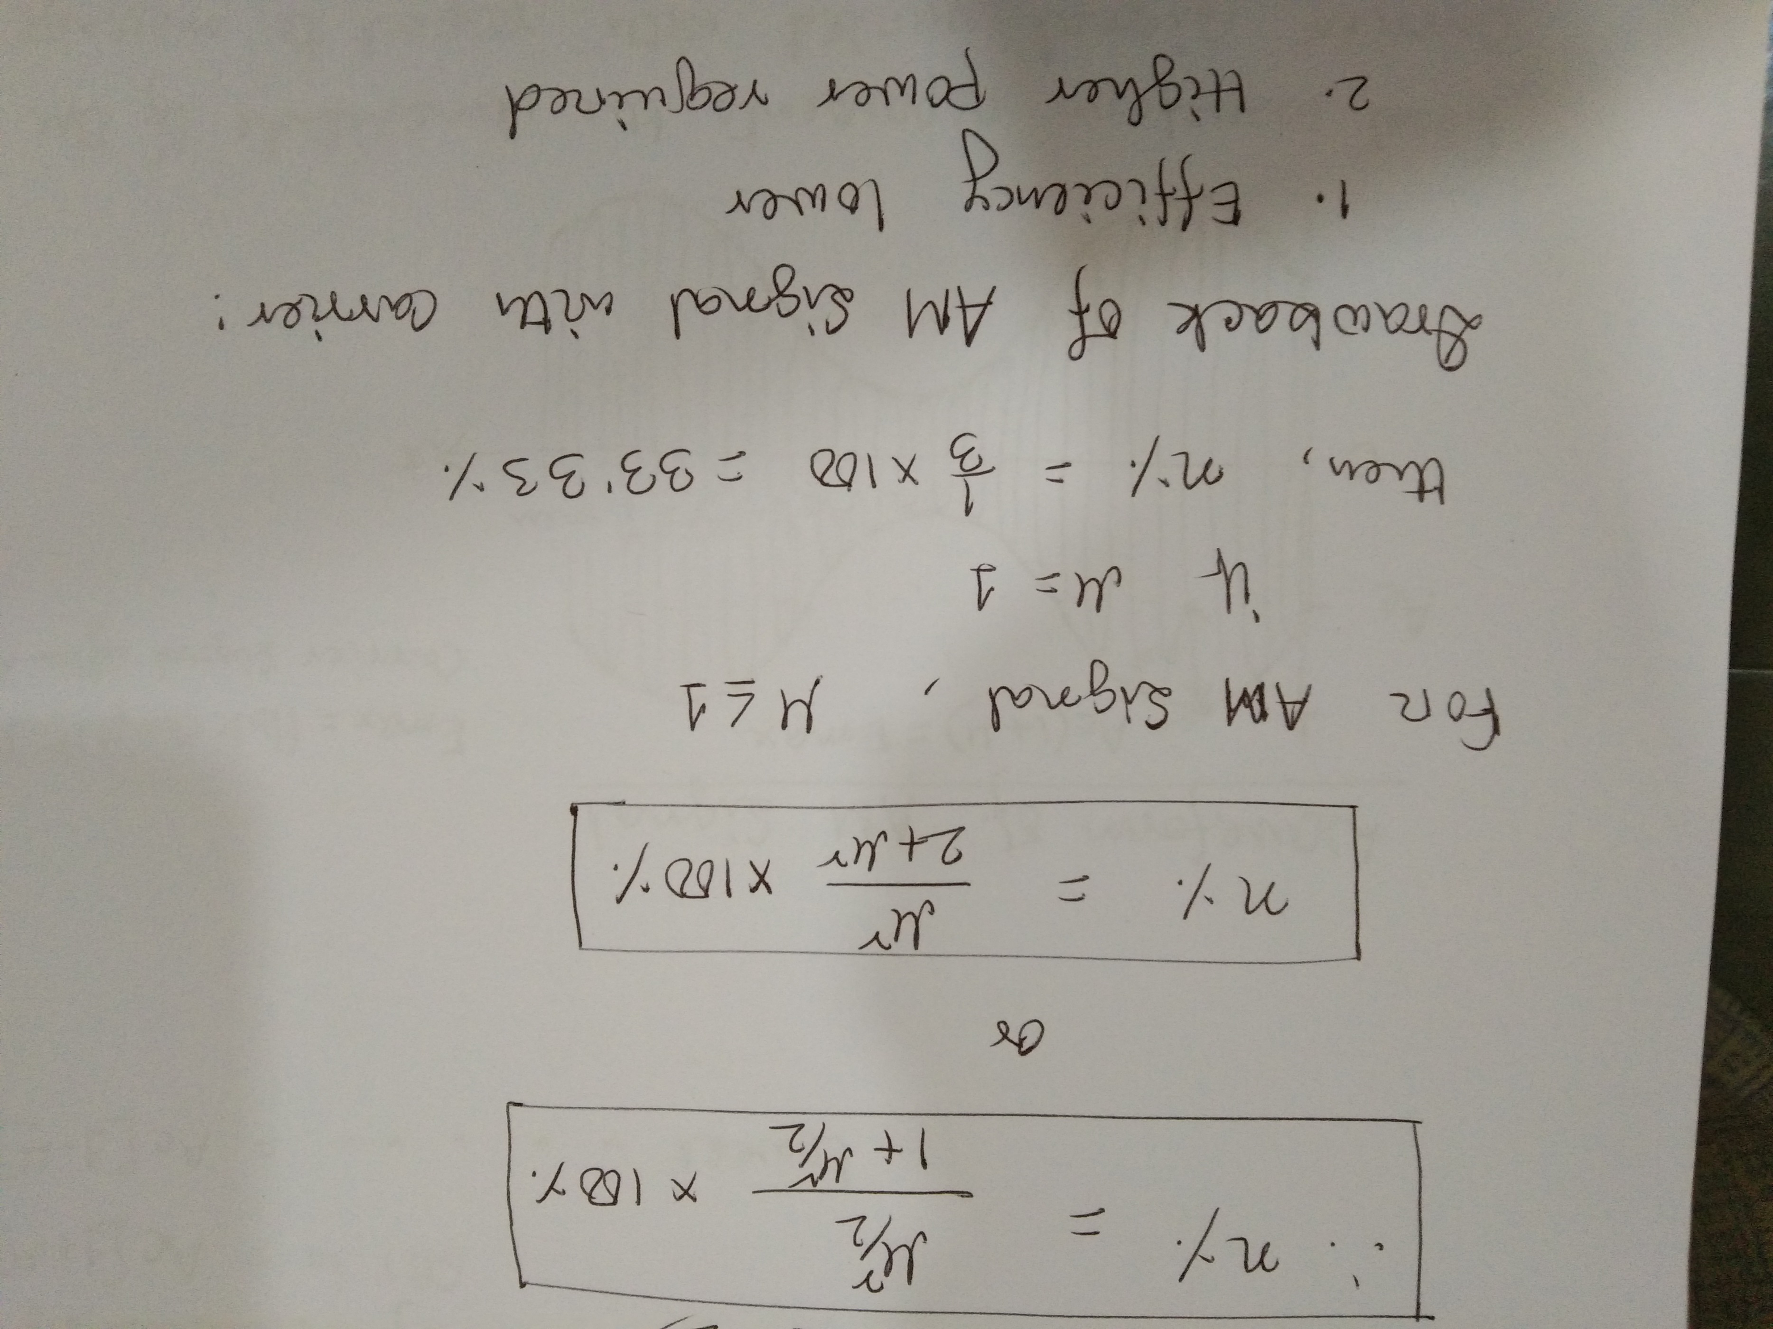

Slide 12
Double Sideband-Suppressed Carrier
DSB-SC AM

Slide 13
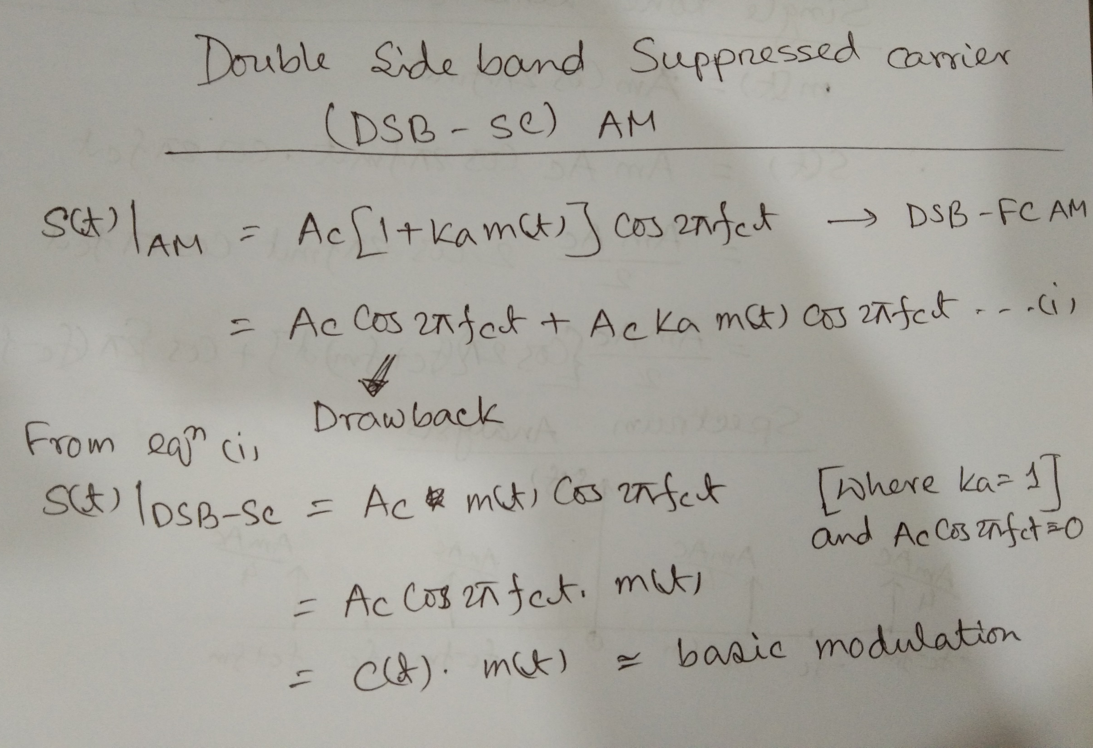

Slide 14
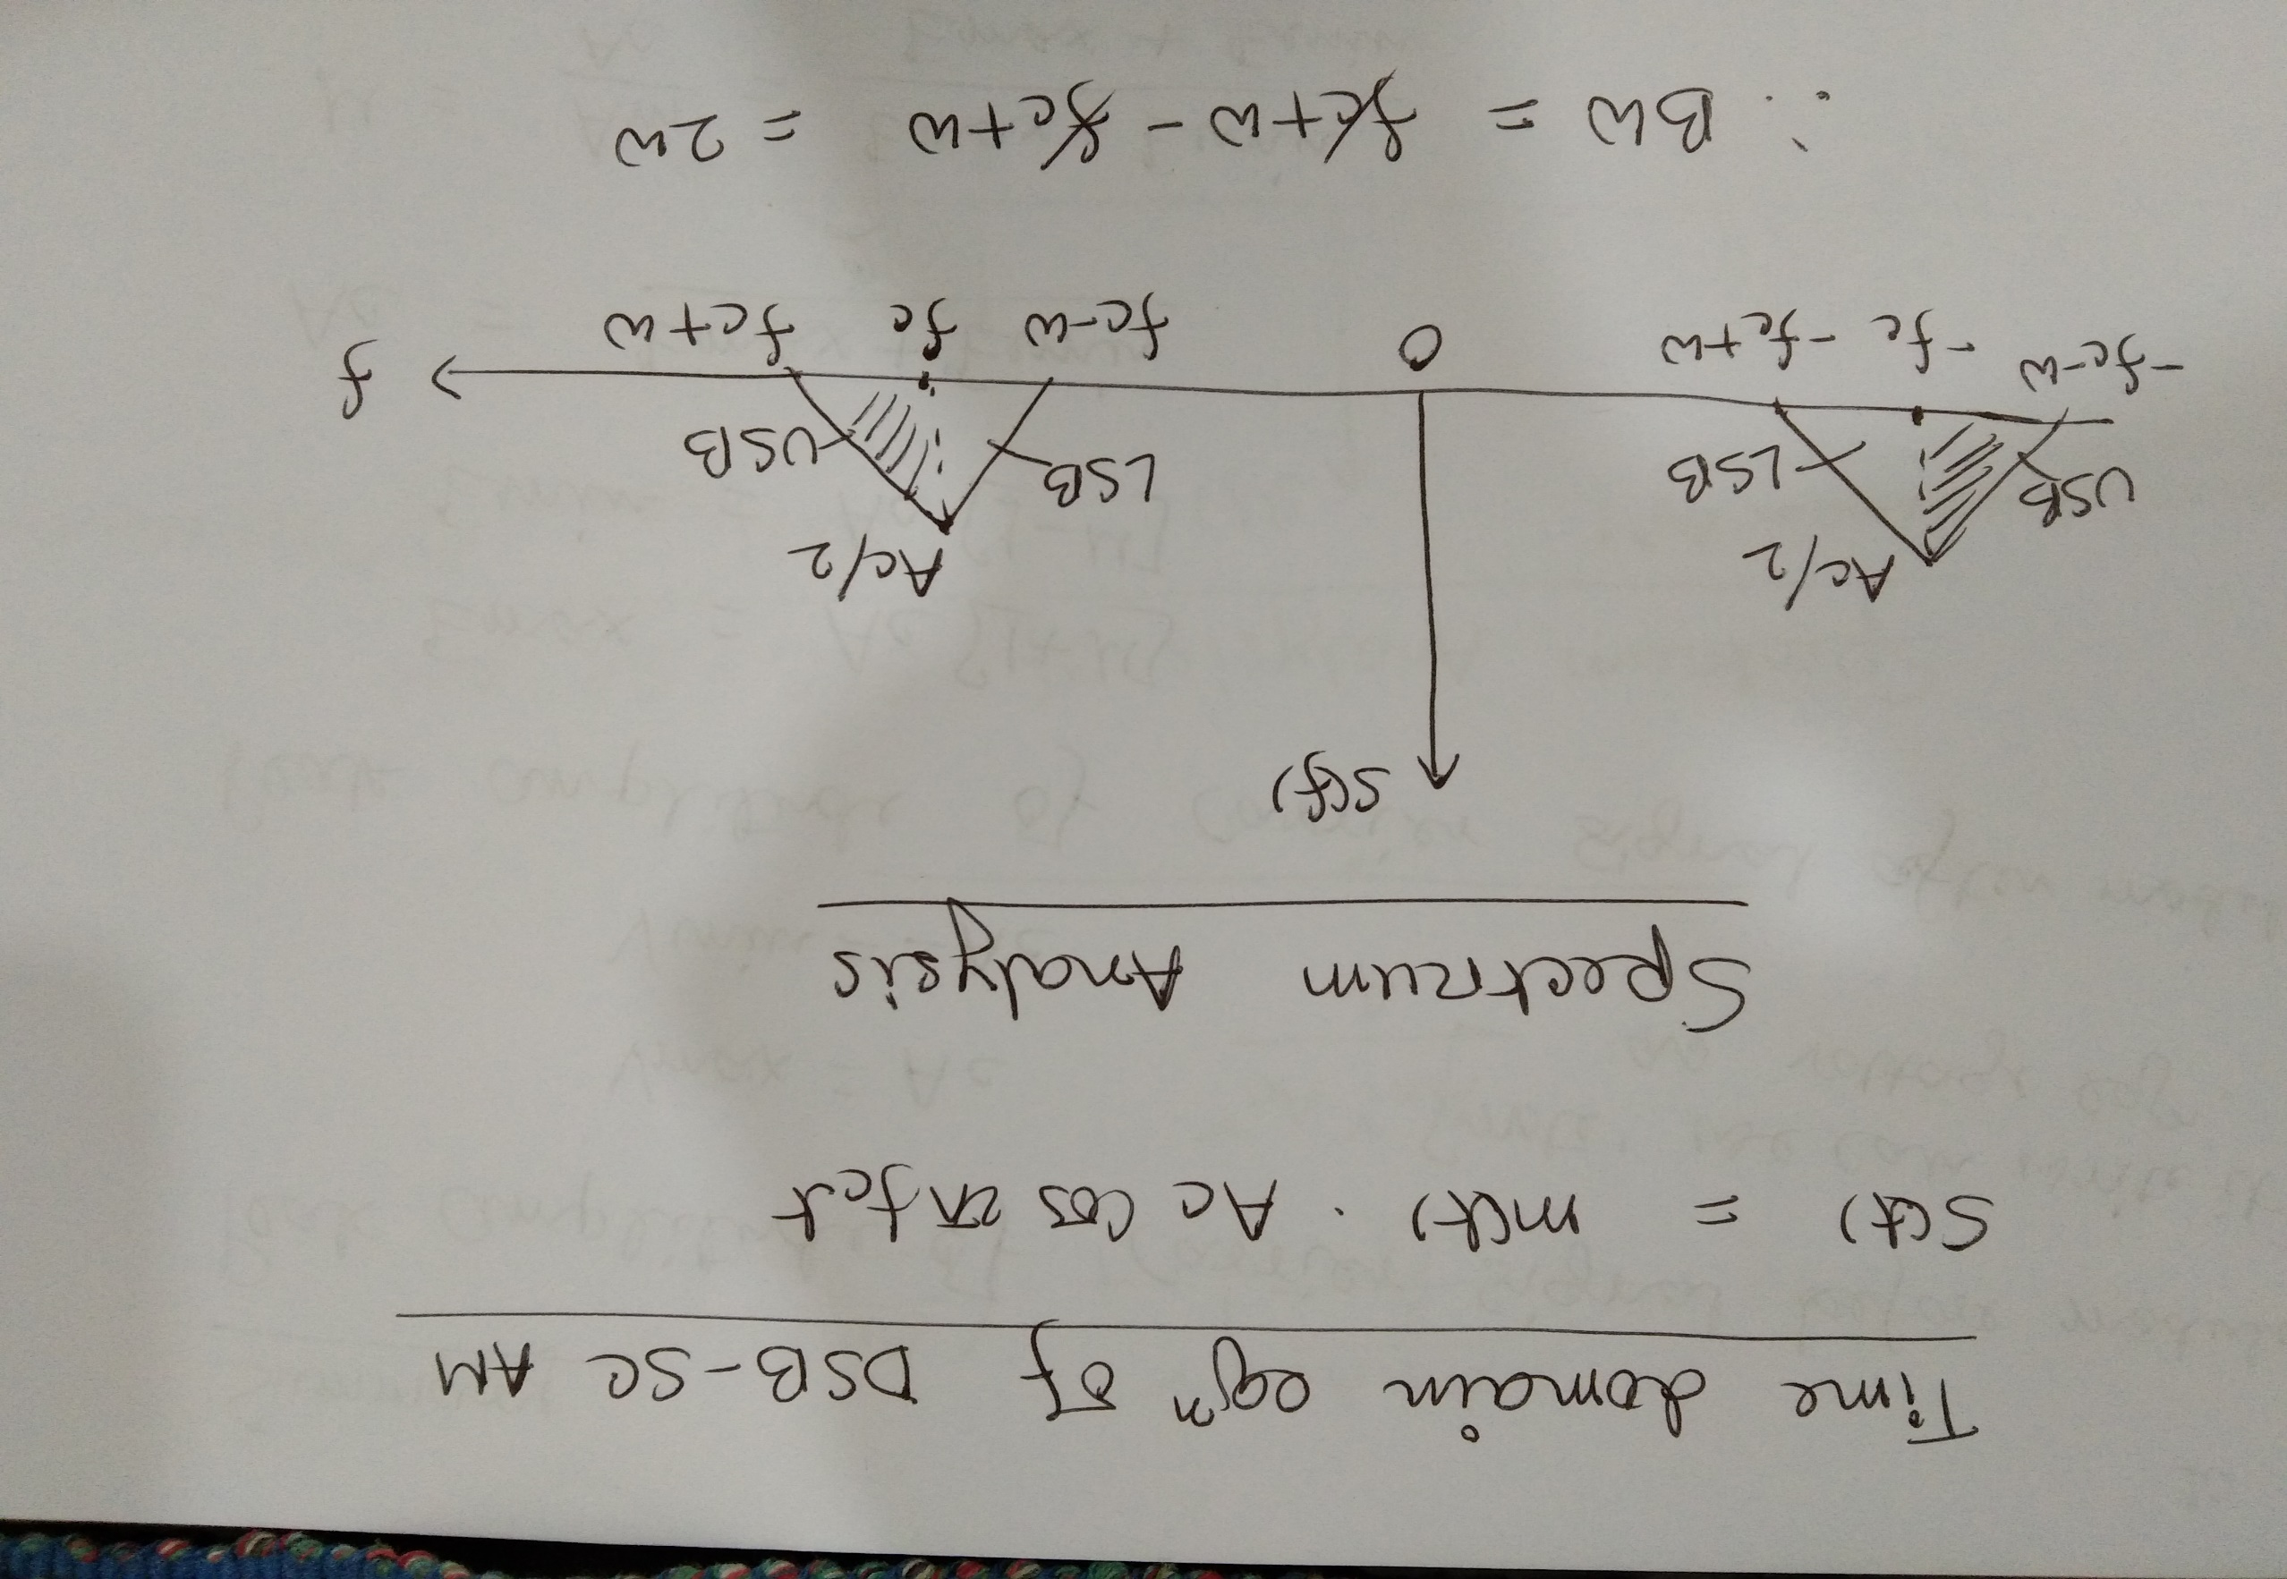

Slide 15
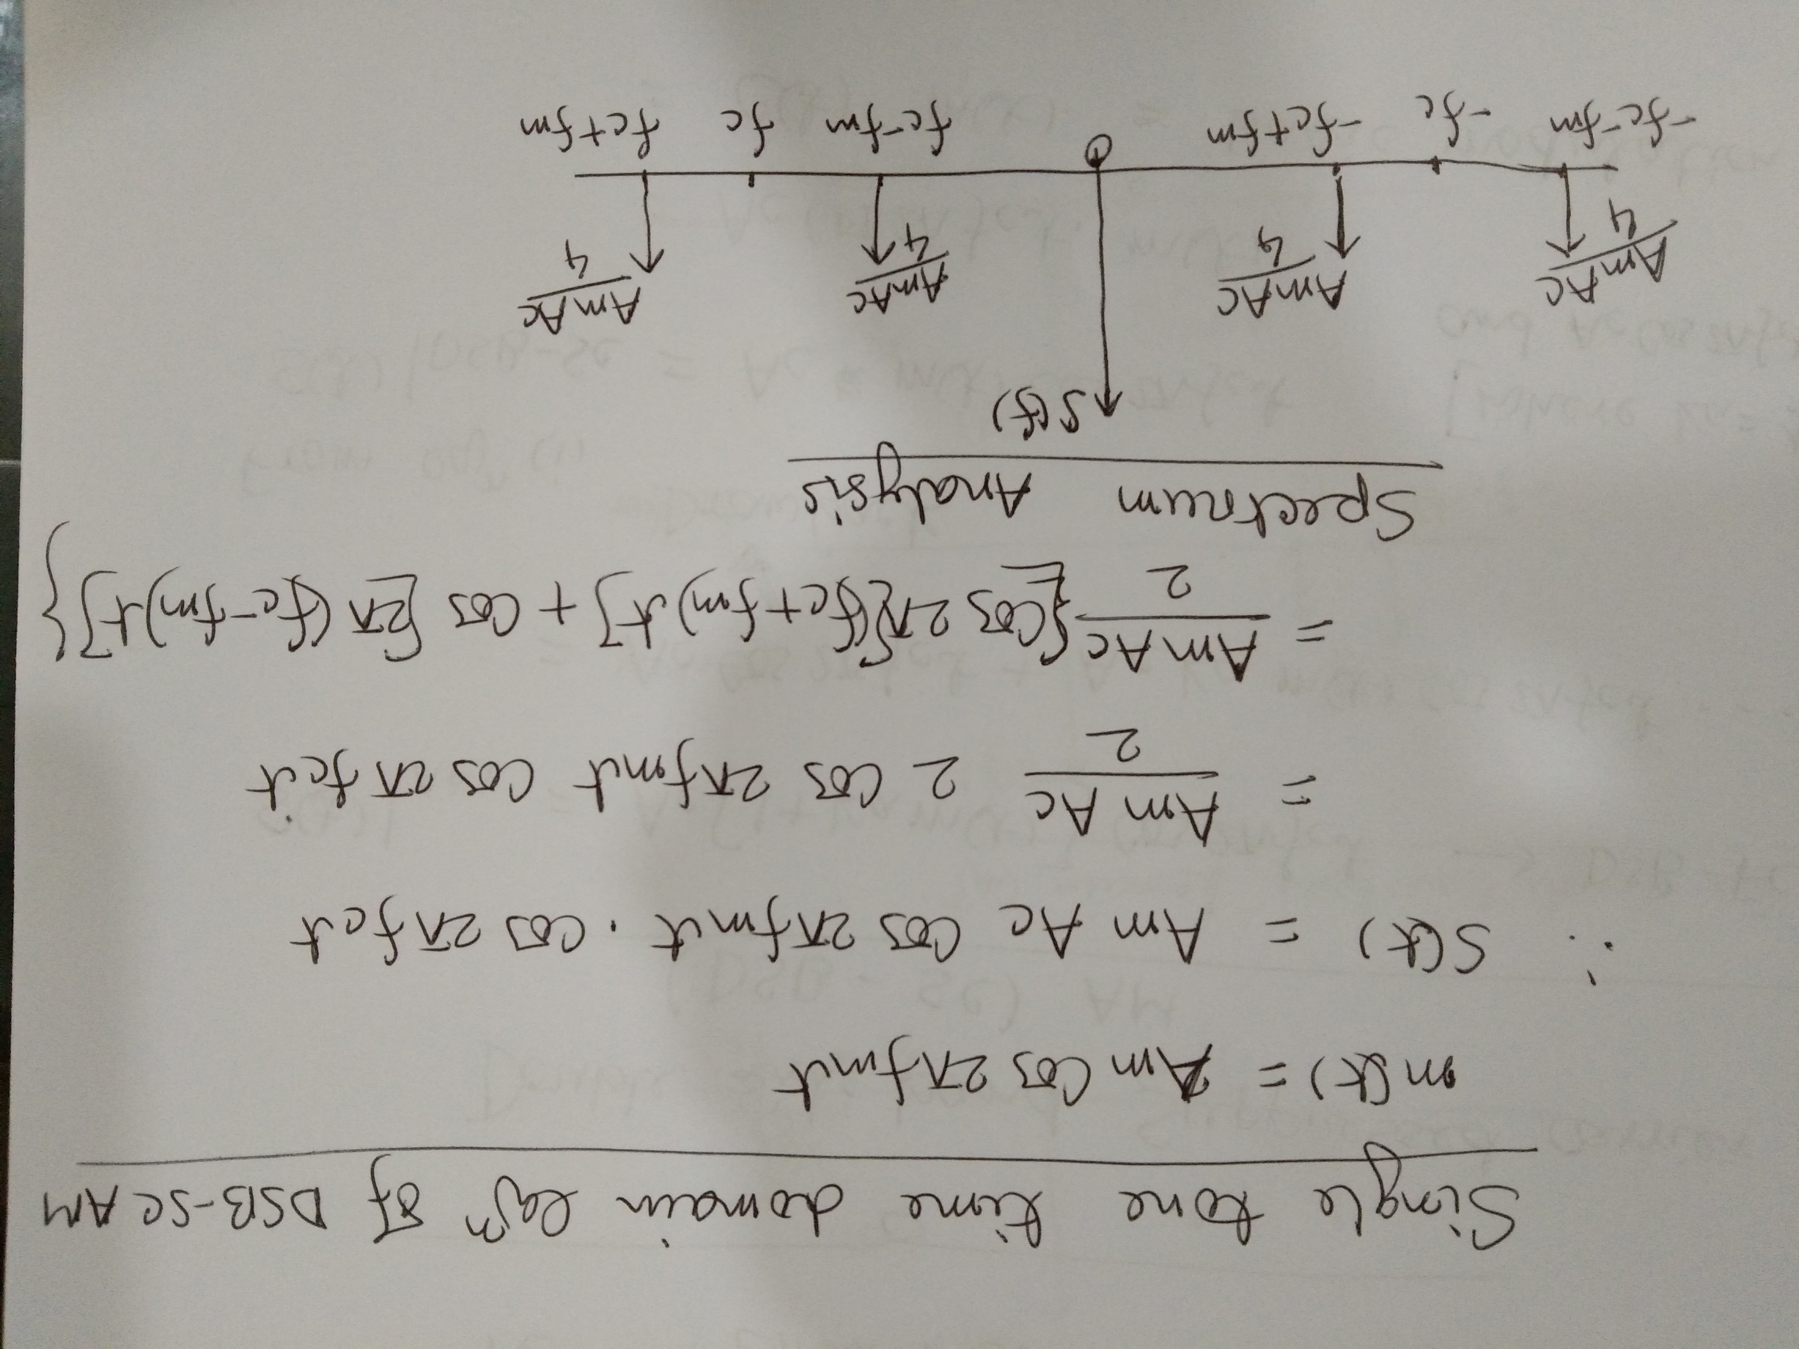

Slide 16
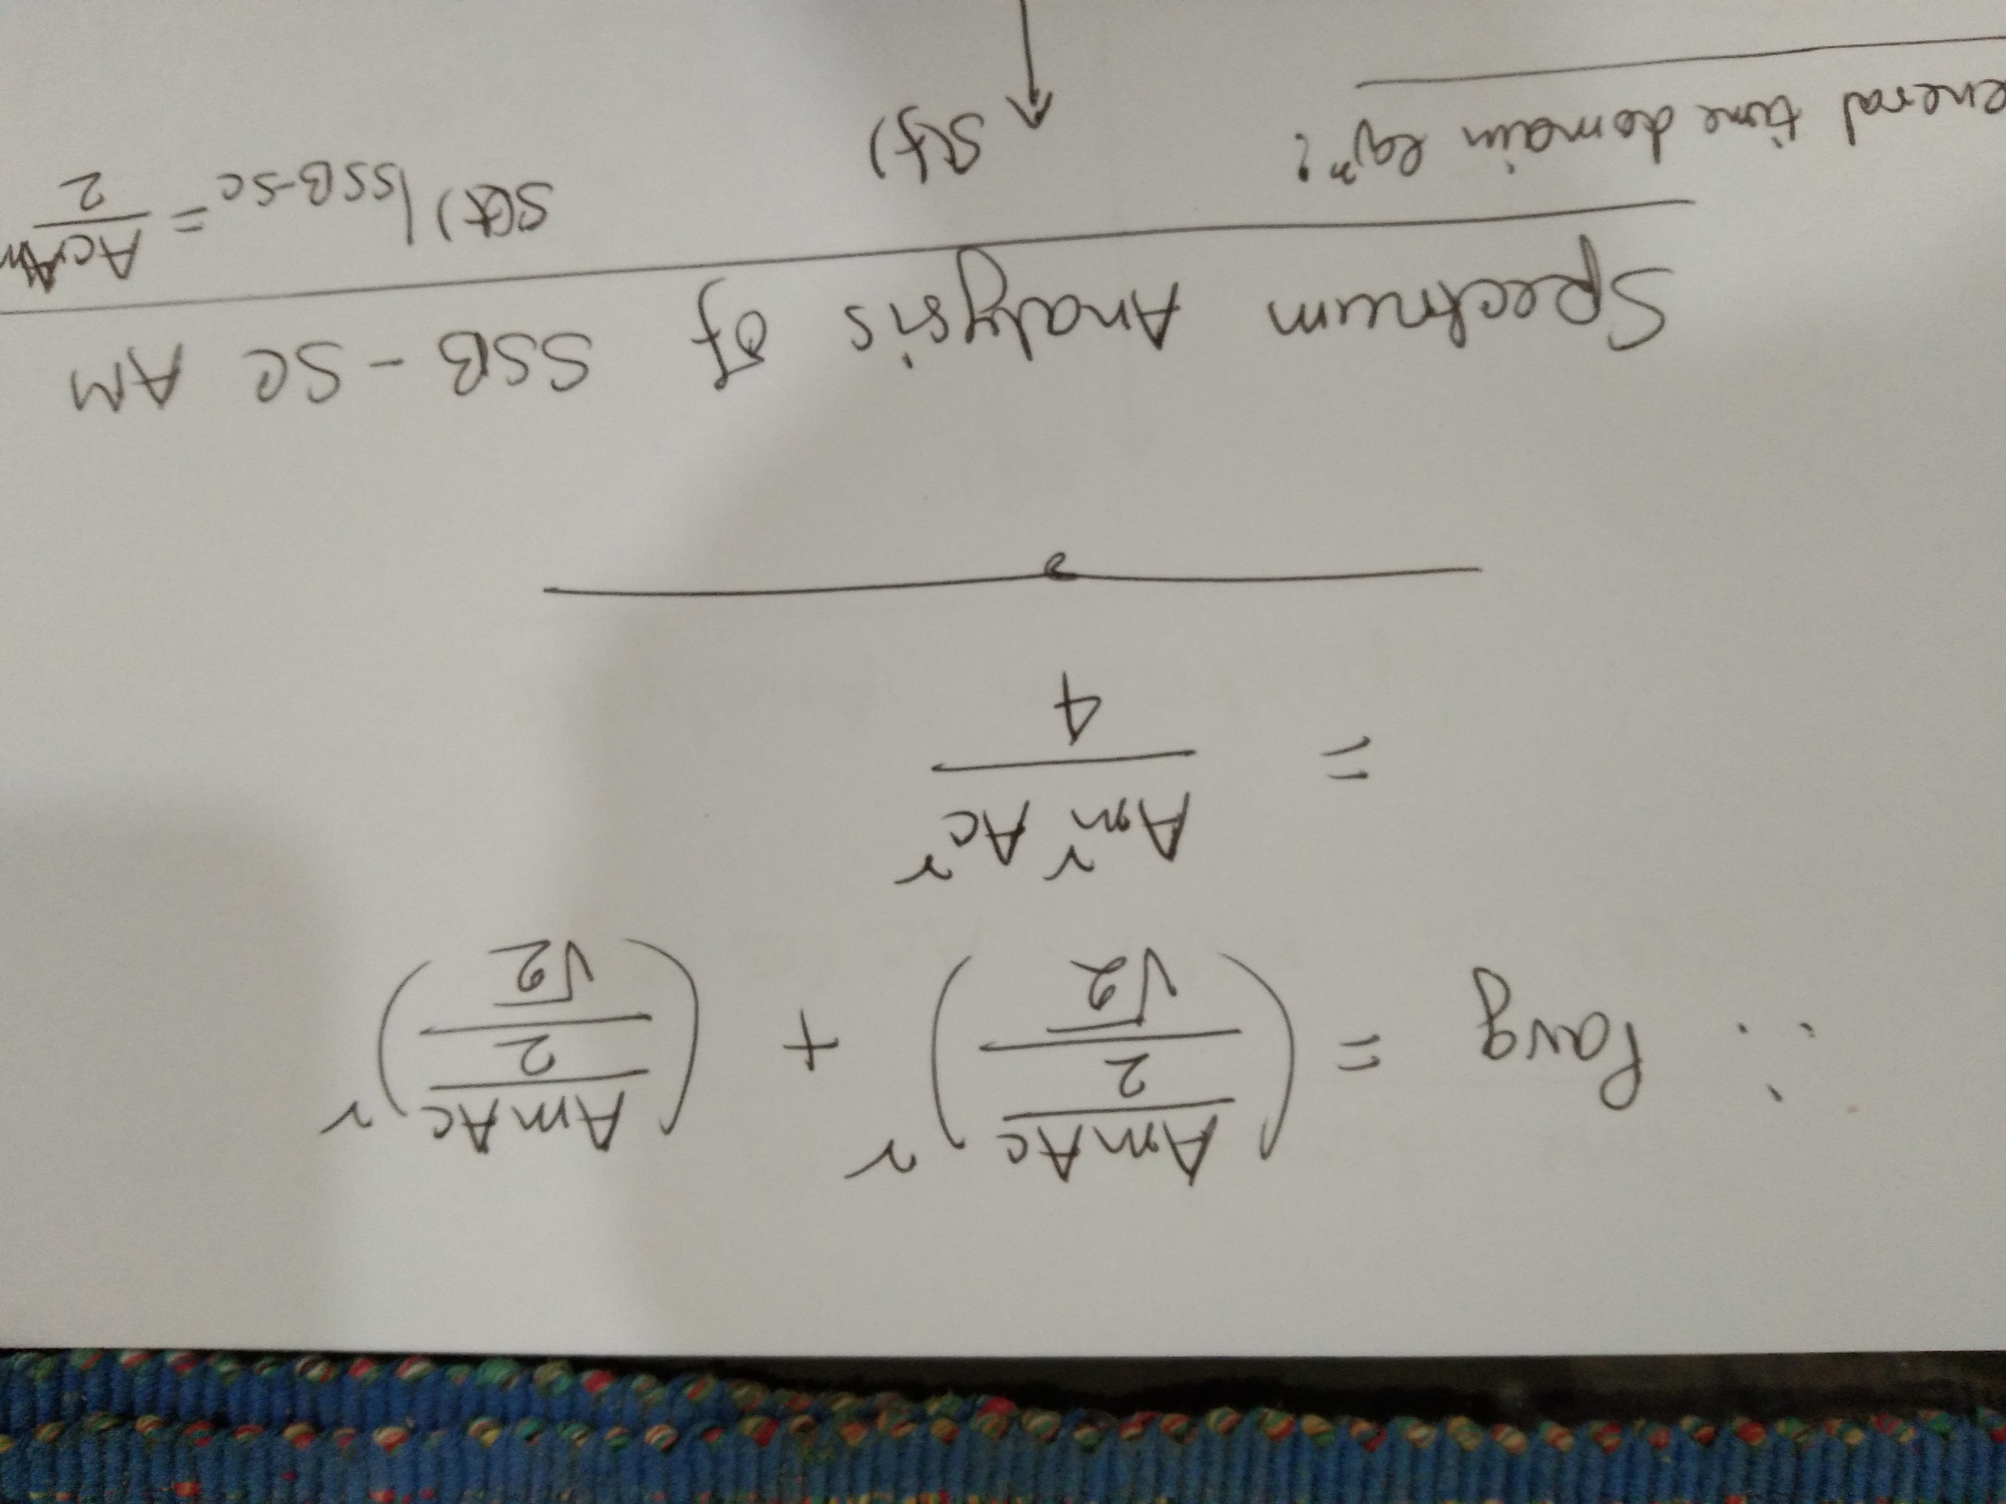

Slide 17
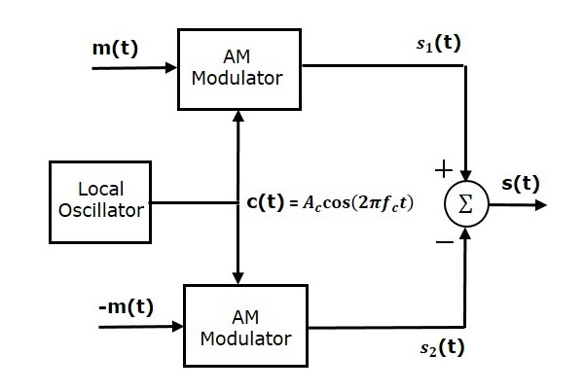
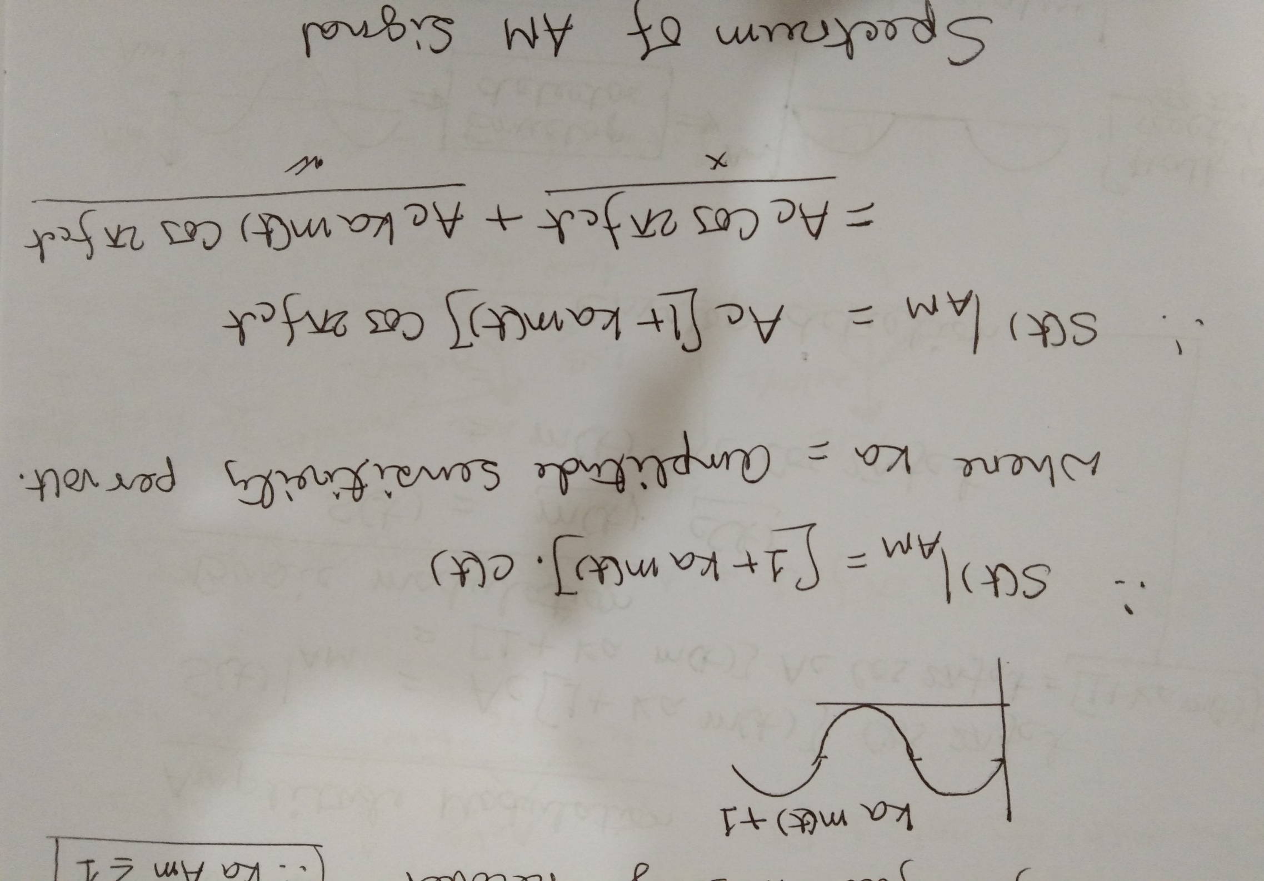
1. Balance Modulator DSB-SC

Slide 18
Balance Modulator DSB-SC
It is consists of two identical AM modulators. These two modulators are arranged in a balanced configuration in order to suppress the carrier signal. Hence, it is called as Balanced modulator.
The same carrier signal c(t)=Ac cos(2πfct) is applied as one of the inputs to these two AM modulators. The modulating signal m(t) is applied as another input to the upper AM modulator. Whereas, the modulating signal m(t) with opposite polarity, i.e., −m(t) is applied as another input to the lower AM modulator.
Output of the upper AM modulator is
s1(t)=Ac[1+ ka m(t)]cos(2πfct)
Output of the lower AM modulator is
s2(t)=Ac[1− ka m(t)]cos(2πfct)

Slide 19
Balance Modulator DSB-SC
We get the DSB-SC wave s(t) by subtracting s2(t) from s1(t). The summer block is used to perform this operation. Thus, the summer block produces an output s(t) which is the difference of s1(t) and s2(t).
⇒s(t)=2Ac ka m(t) cos(2πfct)
We know the standard equation of DSBSC wave is
s(t)= m(t) Ac cos(2πfct) = m(t) c(t)
By comparing the output of summer block with the standard equation of DSB-SC wave, we will get the scaling factor as 2ka.

Slide 20
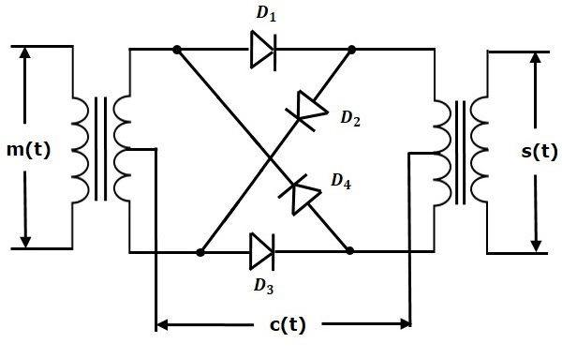
2. Ring Modulator DSB-SC

Slide 21
Ring Modulator
In this diagram, the four diodes D1,D2,D3 and D4 are connected in the ring structure. Hence, this modulator is called as the ring modulator. Two center tapped transformers are used in this diagram. The message signal m(t) is applied to the input transformer. Whereas, the carrier signals c(t) is applied between the two center tapped transformers.
For positive half cycle of the carrier signal, the diodes D1 and D3 are switched ON and the other two diodes D2 and D4 are switched OFF. In this case, the message signal is multiplied by +1.

Slide 22
Ring Modulator
For negative half cycle of the carrier signal, the diodes D2 and D4 are switched ON and the other two diodes D1 and D3 are switched OFF. In this case, the message signal is multiplied by -1. This results in 180° phase shift in the resulting DSB-SC wave.
From the above analysis, we can say that the four diodes are controlled by the carrier signal.
We will get DSB SC wave s(t), which is just the product of the carrier signal c(t) and the message signal m(t), which represents DSB-SC wave and is obtained at the output transformer of the ring modulator.
s(t)= m(t) Ac cos(2πfct)
DSB-SC modulators are also called as product modulators as they produce the output, which is the product of two input signals.

Slide 23
SSB Modulation

Slide 24
SSB Modulation or SSB-SC
The process of suppressing one of the sidebands, along with the carrier and transmitting a single sideband is called as Single Sideband Suppressed Carrier system (SSB-SC) or simply SSB.

Slide 25
SSB Modulation or SSB-SC Modulation
The two sidebands carry the same information twice. By suppress any one side band is called single side band modulation.
Eq. of DSB-SC modulated signal is
s(t) = m(t) × c(t)
= (Ac Am)/2 (cos2π(fc + fm)t + cos2π(fc- fm)t)
Eq. of SSB-SC
s(t) = (Ac Am)/2 cos(2π(fc + fm)t) …… for USB only
s(t) = (Ac Am)/2 cos(2π(fc - fm)t)…….. For LSB only

Slide 26
Generation of SSB using side band filter
DSB-SC signal
BPF with BW (w)
SSB signal

Slide 27
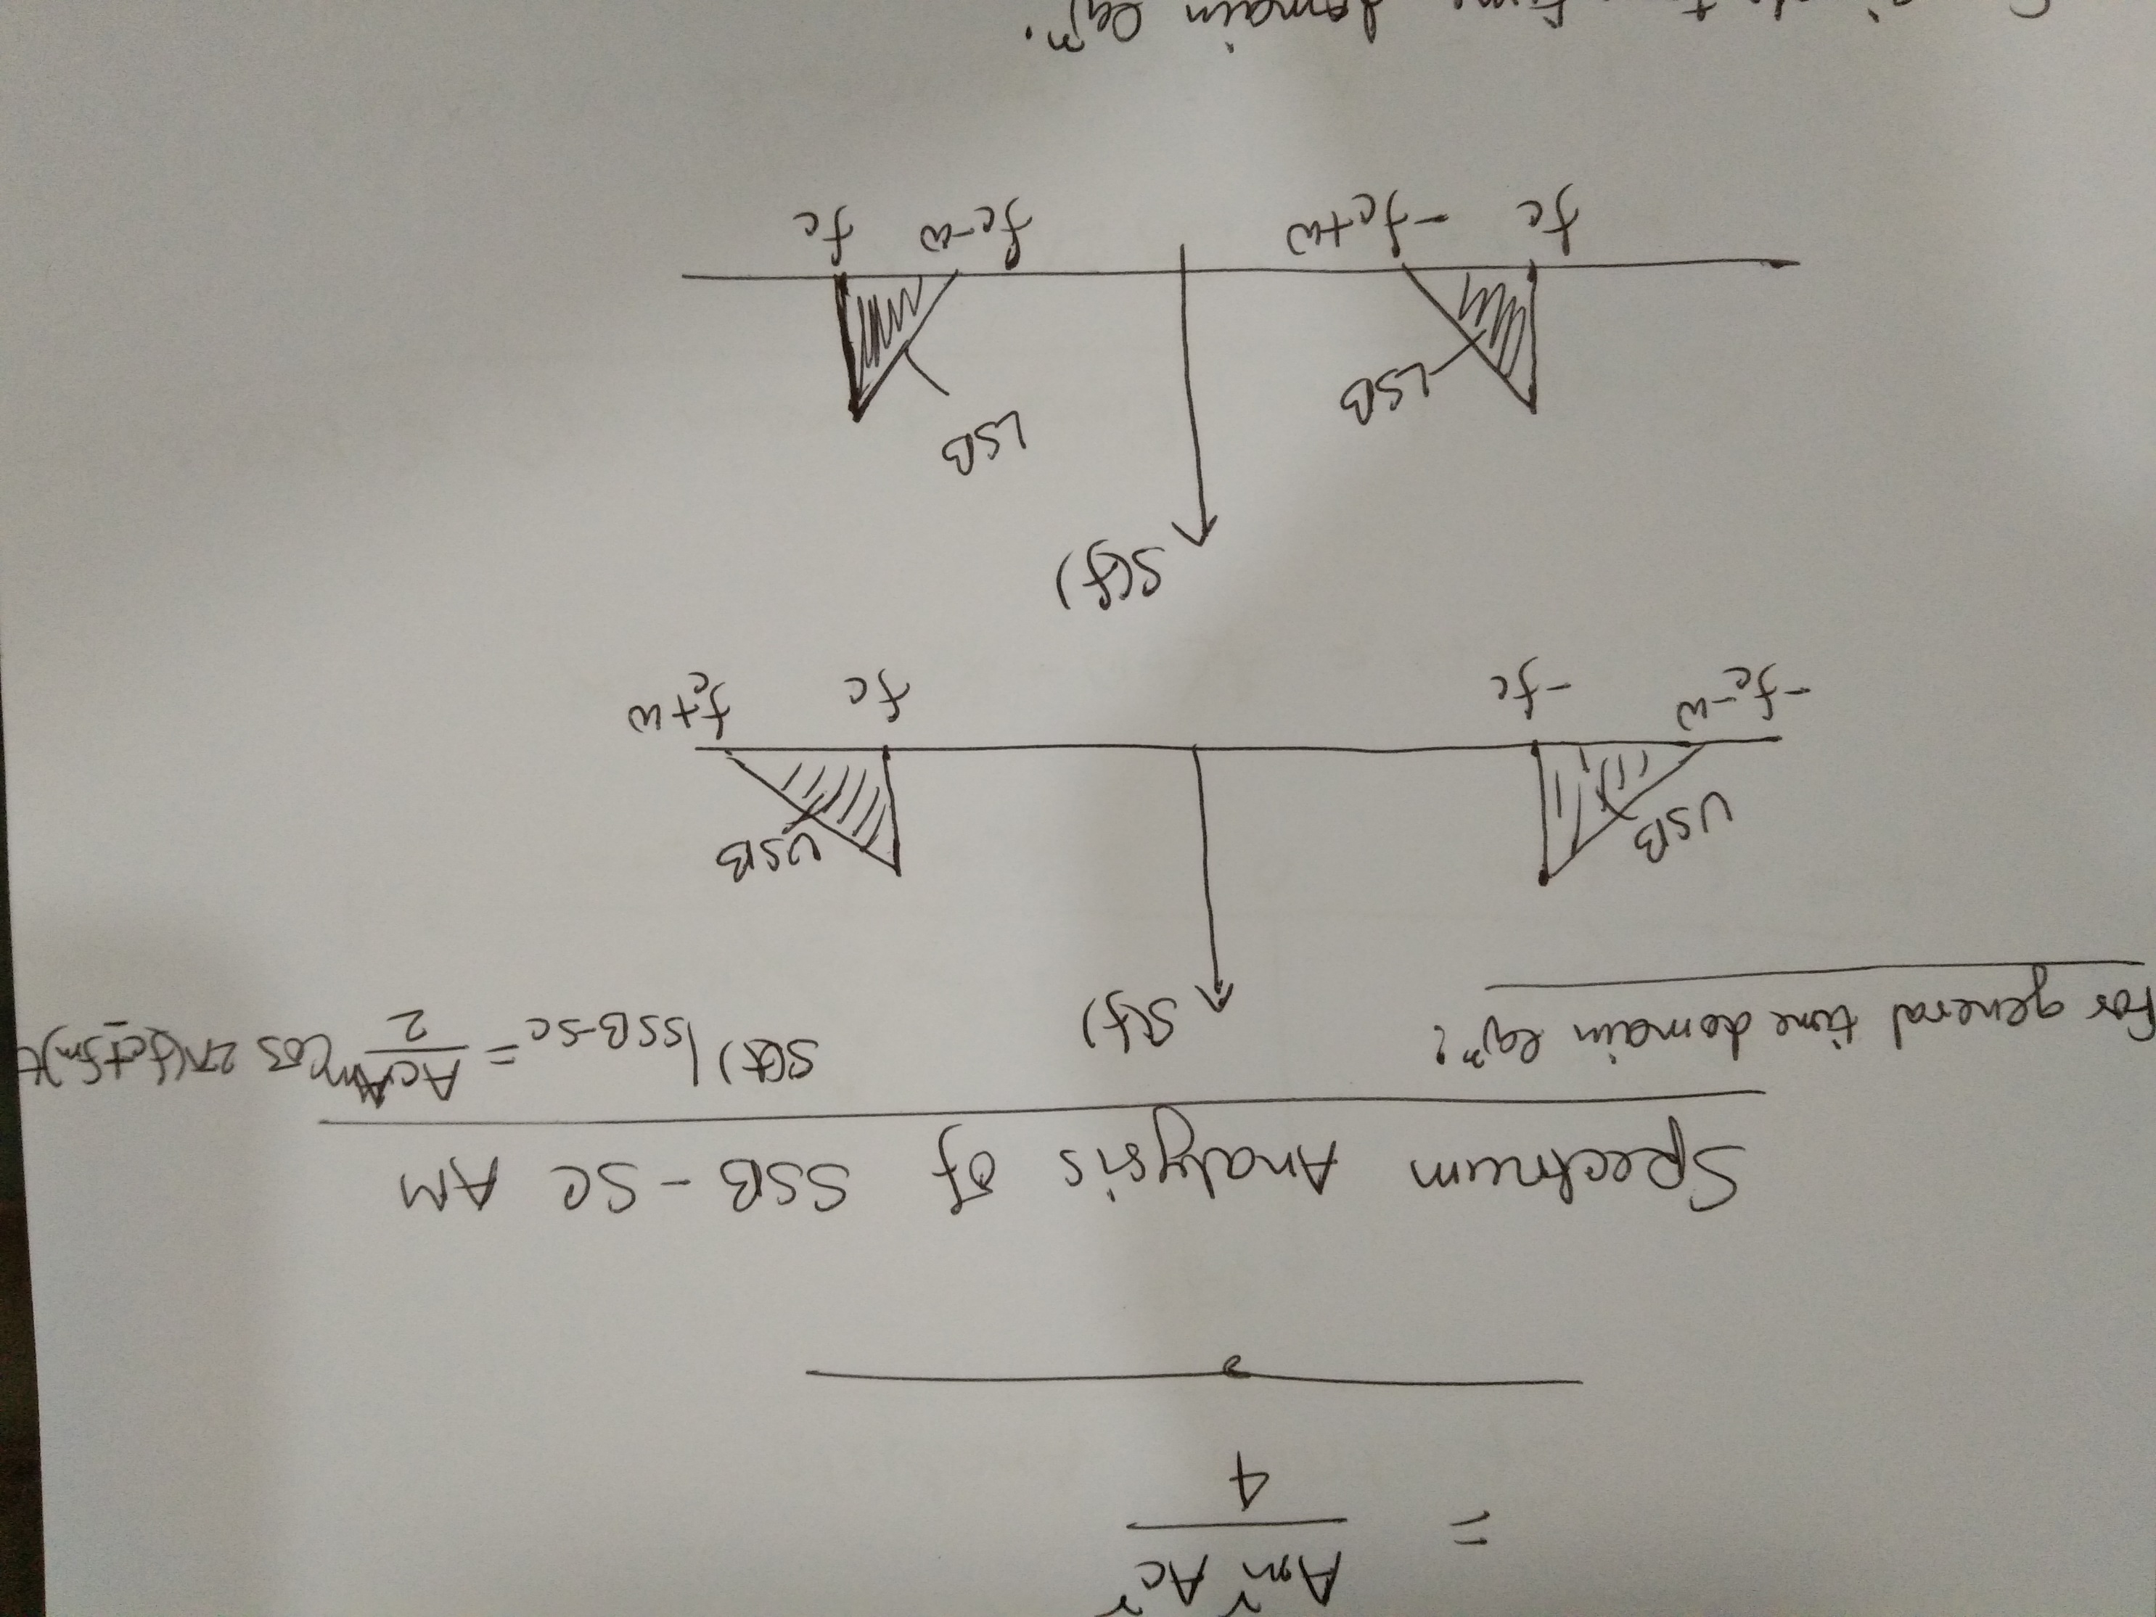

Slide 28
